Slide 1
Gaussian linear mixed models to analyze repeated measure data

Slide 2
Outline
Characteristics of repeated measure data
Motivating example
Review of frequentist models
Modeling the mean
Modeling the correlation structure
Modeling heterogeneous variances
Bayesian analysis:
Priors
Model comparison and testing

Slide 3
Characteristics of repeated measure data
Mean
External factors (treatments, contemporary groups)
Time-dependent trend
Possible interaction with external factors
(most commonly) This is the object of inference
Correlation structure
Within animal, between measurement correlation usually present
Function of time and/or differences between time point
This is treated (generally) as nuisance parameters
Heterogeneous variances
In general there is variance heterogeneity over time

Slide 4
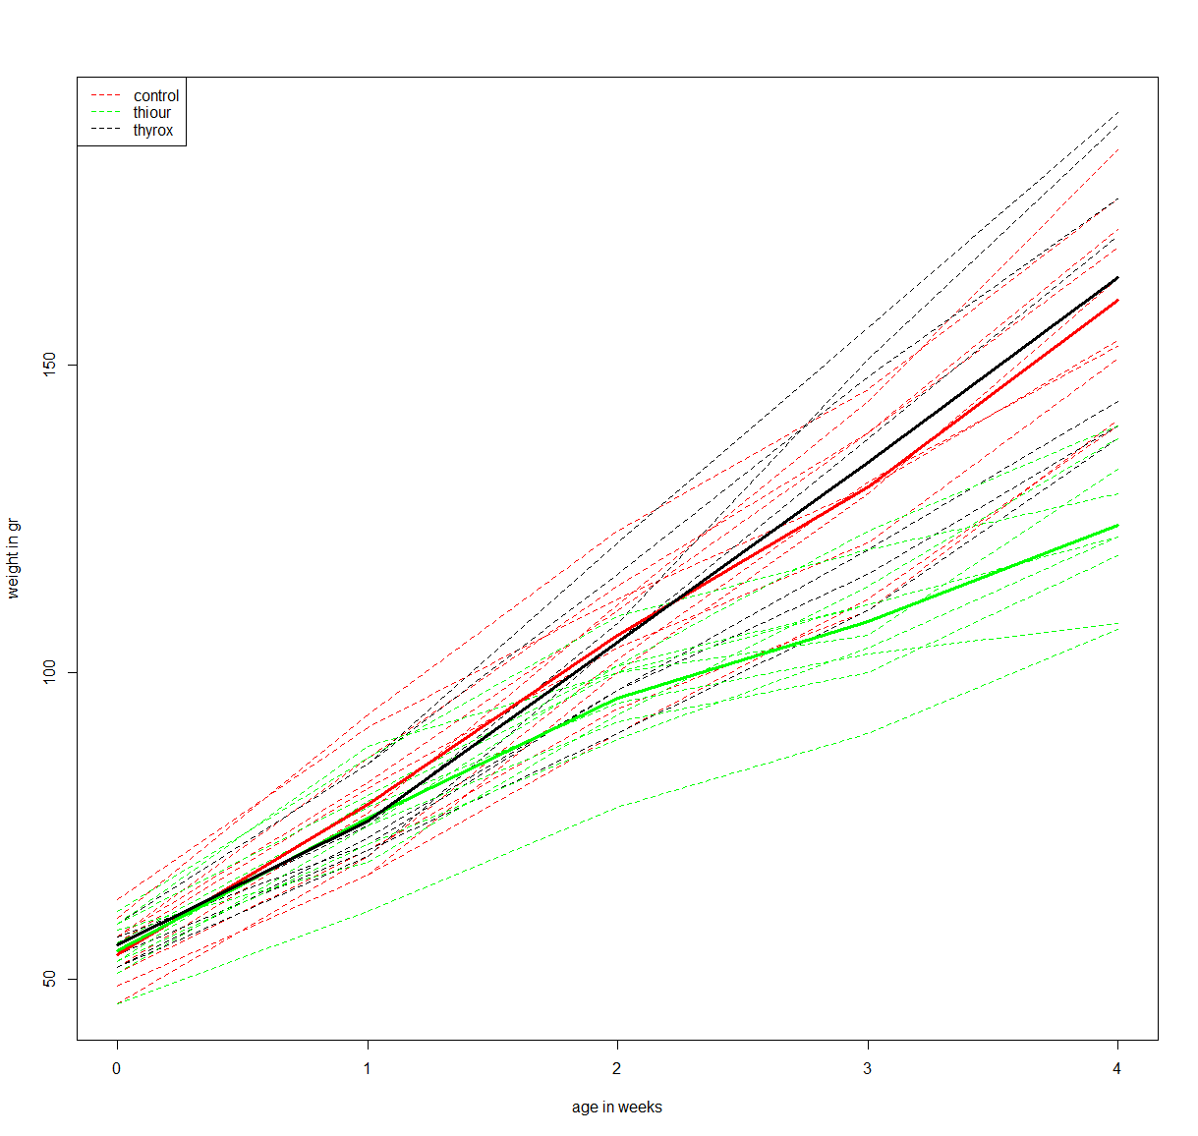
Motivating example
Weights of 27 rats
subject to 3 treatments
measured over a 5 week period
Mean Time-trend
Group- specific time-trend
Heteroskedasticity
Group- specific time-trend

Slide 5



A general linear model, frequentist version
Correlation and variance over time are modeled by both, residuals and random effects
$$Y\sim N(Xb,ZGZ^{′}+R)$$
$$y=Xb+Zu+e$$
Population-specific
mean model
(fixed effects)
Unexplained variation
Individual-specific departure from population mean.
$$e\sim N(0,R)$$
$$u\sim N(0,G)$$

Slide 6
Modeling the mean
Treat times as categories
Only possible if a small number of time points are measures
In particular: Same times measured in all individuals
Tend to model means better at the expense of possible over fitting
Preferred first step when comparing covariances structures
Treat time as a continuous variable and fit a regression on it
Under fitting can lead to biased residual and random effects estimates (affects covariance structure selection)
Consider alternative linear models (and in some cases non-linear models)
Don’t limit yourself to a straight line and don’t abuse polynomial regression
If you use polynomial regression, perform variable selection

Slide 7



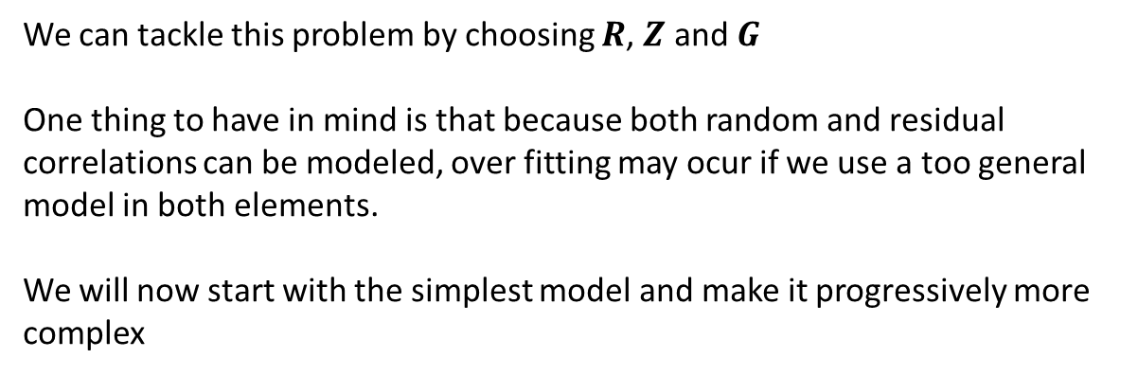
Modeling the correlation structure
$$y=Xb+Zu+e$$
$$e\sim N(0,R)$$
$$u\sim N(0,G)$$
$$y\sim N(Xb,ZGZ^{′}+R)$$
We can tackle this problem by choosing $R$, $Z$ and $G$
One thing to have in mind is that because both random and residual correlations can be modeled, over fitting may ocur if we use a too general model in both elements.
We will now start with the simplest model and make it progressively more complex

Slide 8



Modeling the correlation structure: the simplest model
$$y=Xb+e$$
$$e\sim N(0,R)$$
$$y\sim N(Xb, R)$$
$$R=Iσ_{e}^{2}$$
Correlation between repeated measures: zero
Variances over time: constant (heteroskedastic)
This is the simplest model and (most often) it does not fit the data well at all
Let’s add a single component

Slide 9






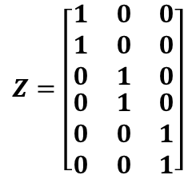


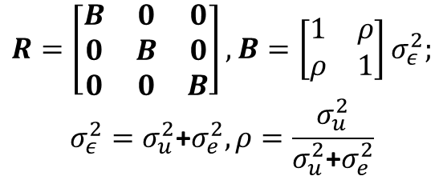
Modeling the correlation structure: Compound symmetry model
$$y=Xb+Zu+e$$
$$R=Iσ_{e}^{2}$$
$$Z=\left[\begin{aligned}\begin{matrix}1 & 0 & 0 \\ 1 & 0 & 0 \\ 0 & 1 & 0\end{matrix} \\ \begin{matrix}0 & 1 & 0 \\ 0 & 0 & 1 \\ 0 & 0 & 1\end{matrix}\end{aligned}\right]$$
One column per individual, row element is 1 if observation belong to the individual.
$$u\sim N(0,G)$$
$$e\sim N(0,R)$$
$$y\sim N(Xb, Σ=ZGZ^{′}+R)$$
$$var\left(u\right)=G=Iσ_{u}^{2}$$
$Σ=\left[\begin{matrix}B & 0 & 0 \\ 0 & B & 0 \\ 0 & 0 & B\end{matrix}\right], B=\left[\begin{matrix}σ_{u}^{2}\text{+}σ_{e}^{2} & σ_{u}^{2} \\ σ_{u}^{2} & σ_{u}^{2}\text{+}σ_{e}^{2}\end{matrix}\right]$=$\left[\begin{matrix}1 & ρ \\ ρ & 1\end{matrix}\right]\left(σ_{u}^{2}\text{+}σ_{e}^{2}\right),ρ=\frac{σ_{u}^{2}}{σ_{u}^{2}\text{+}σ_{e}^{2}}$
Adding an independent animal effect (intercept) in the model results in a compound symmetry structure. There is an equivalent model:
$$R=\left[\begin{matrix}B & 0 & 0 \\ 0 & B & 0 \\ 0 & 0 & B\end{matrix}\right], B=\left[\begin{matrix}1 & ρ \\ ρ & 1\end{matrix}\right]σ_{ε}^{2};$$
$${σ_{ε}^{2}=σ}_{u}^{2}\text{+}σ_{e}^{2},ρ=\frac{σ_{u}^{2}}{σ_{u}^{2}\text{+}σ_{e}^{2}}$$
$$y=Xb+ε$$

Slide 10


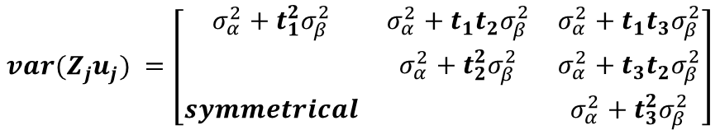


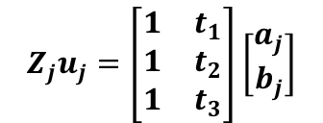


Modeling the correlation structure: add an animal specific slope (independent)
$$y=Xb+Zu+e$$
$$R=Iσ_{e}^{2}$$
$$e\sim N(0,R)$$
$$Z_{j}u_{j}=\left[\begin{matrix}1 & t_{1} \\ 1 & t_{2} \\ 1 & t_{3}\end{matrix}\right]\left[\begin{matrix}a_{j} \\ b_{j}\end{matrix}\right]$$
$$var\left(\left[\begin{matrix}a_{j} \\ b_{j}\end{matrix}\right]\right)=\left[\begin{matrix}σ_{α}^{2} & 0 \\ 0 & σ_{β}^{2}\end{matrix}\right]$$
$$u\sim N(0,G)$$
$$y\sim N(Xb, Σ=ZGZ^{′}+R)$$
$${var(Z}_{j}u_{j}) =\left[\begin{matrix}σ_{α}^{2}+t_{1}^{2}σ_{β}^{2} & σ_{α}^{2}+t_{1}t_{2}σ_{β}^{2} & σ_{α}^{2}+t_{1}t_{3}σ_{β}^{2} \\ & σ_{α}^{2}+t_{2}^{2}σ_{β}^{2} & σ_{α}^{2}+t_{3}t_{2}σ_{β}^{2} \\ symmetrical & & σ_{α}^{2}+t_{3}^{2}σ_{β}^{2}\end{matrix}\right]$$
Notice that variance is a function of time (heteroskedasticity) and that correlation is a function of the pairs of times considered:
$$var\left(y(t)\right)=σ_{α}^{2}+t_{}^{2}σ_{β}^{2}+σ_{e}^{2}$$
$$cov\left(y\left(t_{1}\right),y(t_{2})\right)=\left\{\begin{matrix}0 \\ σ_{α}^{2}+t_{1}t_{2}σ_{β}^{2}\end{matrix}\right.$$

Slide 11



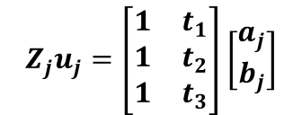


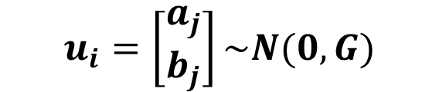
Modeling the correlation structure: add an animal specific slope (co-varying)
$$y=Xb+Zu+e$$
$$u_{i}=\left[\begin{matrix}a_{j} \\ b_{j}\end{matrix}\right]\sim N(0,G)$$
$$e\sim N(0,R)$$
$$R=Iσ_{e}^{2}$$
$$Z_{j}u_{j}=\left[\begin{matrix}1 & t_{1} \\ 1 & t_{2} \\ 1 & t_{3}\end{matrix}\right]\left[\begin{matrix}a_{j} \\ b_{j}\end{matrix}\right]$$
$$var\left(\left[\begin{matrix}a_{j} \\ b_{j}\end{matrix}\right]\right)=\left[\begin{matrix}σ_{α}^{2} & σ_{αβ} \\ sym & σ_{β}^{2}\end{matrix}\right]$$
$$y\sim N(Xb, Σ=ZGZ^{′}+R)$$
This structure induces a more general variance-covariance matrix structure:
$$var\left(y(t)\right)=σ_{α}^{2}+2tσ_{αβ}+t_{}^{2}σ_{β}^{2}+σ_{e}^{2}$$
$$cov\left(y\left(t_{1}\right),y(t_{2})\right)=\left\{\begin{matrix}0 \\ σ_{α}^{2}+σ_{αβ}({t_{1}+t}_{2})+{t_{1}t}_{2}σ_{β}^{2}\end{matrix}\right.$$

Slide 12
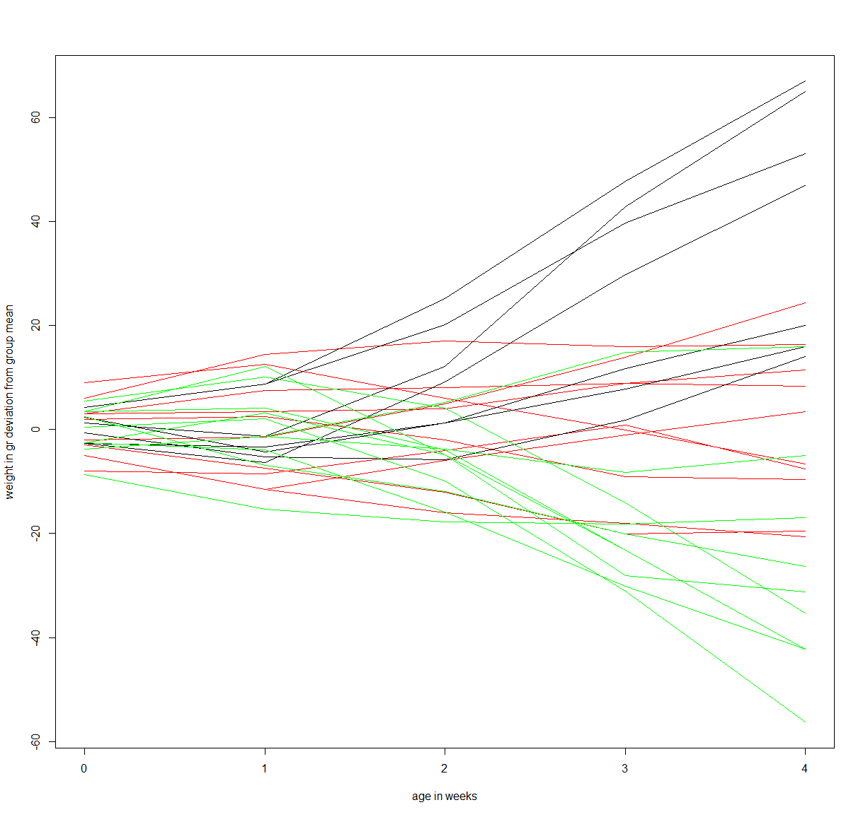
Alternative interpretation of random coefficient model
The individual regressions are a deviation from the group mean

Slide 13


Modeling heterogeneous variances
$$y=Xb+Zu+e$$
$$e\sim N(0,R)$$
$$y\sim N(Xb,ZGZ^{′}+R)$$
$$u\sim N(0,G)$$
There are many different ways to introduce heterogeneity in the residual variance matrix to reflect heteroskedasticity over time
In this class we will deal only with the simplest model:
Each element of the diagonal of R is a time-specific value
$$R=diag(σ_{t_{i}}^{2})$$
Caution: heterogeneous variances are also modeled by the Zu component so adding heterogeneous residuals to a model may affect estimation of random effect parameters

Slide 14
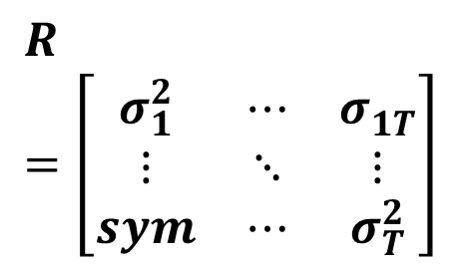

The most complex model (unstructured variance-covariance)
$$y=Xb+e$$
$$R=\left[\begin{matrix}σ_{1}^{2} & ⋯ & σ_{1T}^{} \\ ⋮ & ⋱ & ⋮ \\ sym & ⋯ & σ_{T}^{2}\end{matrix}\right]$$
$$e\sim N(0,R)$$
For T time points, T(T+1)/2 parameters are estimated
Can only be fit if T<n (number of observations per group)
Past a few time points it is not feasible to fit this model

Slide 15
Bayesian analysis with these models
Add priors for all levels
Prior on variances have to be selected carefully
Non-informative priors or almost non-informative priors may lead to (almost) improper posterior
Implement Gibbs sampler
Monitor convergence carefully
Start monitoring convergence of full model (deviance)
Monitor convergence of upper level parameters (co-variances)
Check autocorrelation and cross-correlations
Perform posterior inferences

Slide 16








Bayesian analysis of compound symmetry
$$y=Xb+Zu+e$$
$$y_{i}=X_{i}b+Z_{i}u+e_{i}$$
$$u\sim N(0,Iσ_{u}^{2})$$
$$e_{i}\sim N(0,σ_{e}^{2})$$
Priors
Semi conjugate
(more convenient computationally)
Alternative
$$σ_{e}^{2}\sim I−gamma(α_{e},β_{e})$$
$$σ_{e}^{}\sim U(0,L_{e})$$
$$σ_{u}^{2}\sim I−gamma(α_{u},β_{u})$$
$$σ_{u}^{}\sim U(0,L_{u})$$
Remember equivalence to inverse scaled chi-squared

Slide 17








Bayesian analysis of independent coefficient model
$$y_{i}=X_{i}b+a_{i}+b_{i}t_{i}+e_{i}$$
$$a_{i}\sim N(0,σ_{α}^{2})$$
$$b_{i}\sim N(0,σ_{β}^{2})$$
$$e_{i}\sim N(0,σ_{e}^{2})$$
Priors
Semi conjugate
(more convenient computationally)
Alternative
$$σ_{e}^{2}\sim I−gamma(α_{e},β_{e})$$
$$σ_{e}^{}\sim U(0,L_{e})$$
$$σ_{α}^{2}\sim I−gamma(α_{α},β_{α})$$
$$σ_{α}^{}\sim U(0,L_{α})$$
$$σ_{β}^{2}\sim I−gamma(α_{β},β_{β})$$
$$σ_{β}^{}\sim U(0,L_{β})$$

Slide 18

Bayesian analysis of random coefficient model
$$y_{i}=X_{i}b+a_{i}+b_{i}t_{i}+e_{i}$$
$$\left[\begin{matrix}a_{j} \\ b_{j}\end{matrix}\right]=N\left(0,\left[\begin{matrix}σ_{α}^{2} & σ_{αβ} \\ σ_{αβ} & σ_{β}^{2}\end{matrix}\right]\right)$$
$$e_{i}\sim N(0,σ_{e}^{2})$$
Priors
Semi conjugate
(more convenient computationally)
Alternative
$$σ_{e}^{2}\sim I−gamma(α_{e},β_{e})$$
$$σ_{e}^{}\sim U(0,L_{e})$$
Prior on variance-covariance matrix?

Slide 19

Bayesian analysis of random coefficient model
$$y_{i}=X_{i}b+a_{i}+b_{i}t_{i}+e_{i}$$
$$\left[\begin{matrix}a_{j} \\ b_{j}\end{matrix}\right]=N\left(0,\left[\begin{matrix}σ_{α}^{2} & σ_{αβ} \\ σ_{αβ} & σ_{β}^{2}\end{matrix}\right]\right)$$
$$e_{i}\sim N(0,σ_{e}^{2})$$
Prior on variance-covariance matrix
$$\left[\begin{matrix}σ_{α}^{2} & σ_{αβ} \\ σ_{αβ} & σ_{β}^{2}\end{matrix}\right]\sim I−Wishart \left(Ω,df \right)$$
A priori (proportional) variance-covariance matrix
Degrees of freedom
Larger of equal to matrix dimension

Slide 20
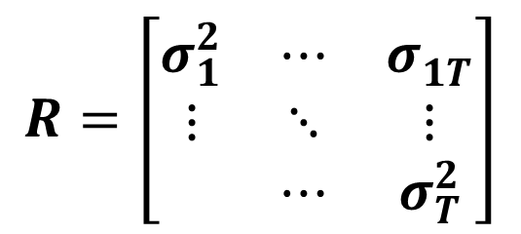


Bayesian analysis of the multivariate (unstructured covariance) model
$$e\sim N(0,R)$$
$$y=Xb+e$$
$$R=\left[\begin{matrix}σ_{1}^{2} & ⋯ & σ_{1T}^{} \\ ⋮ & ⋱ & ⋮ \\ & ⋯ & σ_{T}^{2}\end{matrix}\right]$$
$$R \sim I−Wishart \left(Ω,df \right)$$
For unstructured variance-covariance matrix, inverse whishart is a typical prior

Slide 21



Wishart and inverse Wishart distributions
$$S\sim Wishart \left(V,df \right)$$
Multivariate generalization of the gamma distribution:
$$X=\left\{\begin{matrix}x_{1} & … & x_{k}\end{matrix}\right\}\sim N(0,V)$$
$$S=X^{′}X\sim Wishart \left(V,k \right)$$
Its inverse, will follow the inverse-wishart:
$$R=S^{−1}\sim inv−Wishart \left(V^{−1},k \right)$$
Caution: sometimes the inverse-wishart or the wishart are parameterized in terms of V or its inverse (similar to the gamma and inverse-gamma).

Slide 22


Wishart and inverse Wishart distributions
$$S\sim Wishart \left(V,df \right)$$
Multivariate generalization of the gamma distribution:
$$X_{n}=\left\{\begin{matrix}x_{1} & … & x_{k}\end{matrix}\right\}\sim N(0,V)$$
$$S=X^{′}X\sim Wishart \left(V,k \right)$$
$$f\left(S\right)∝{\left|S\right|}^{\frac{n−k−1}{2}}e^{−\frac{tr\left(V^{−1}S\right)}{2}}$$
Its inverse, will follow the inverse-wishart:
$$R=S^{−1}\sim inv−Wishart \left({W=V}^{−1},k \right)$$

Slide 23
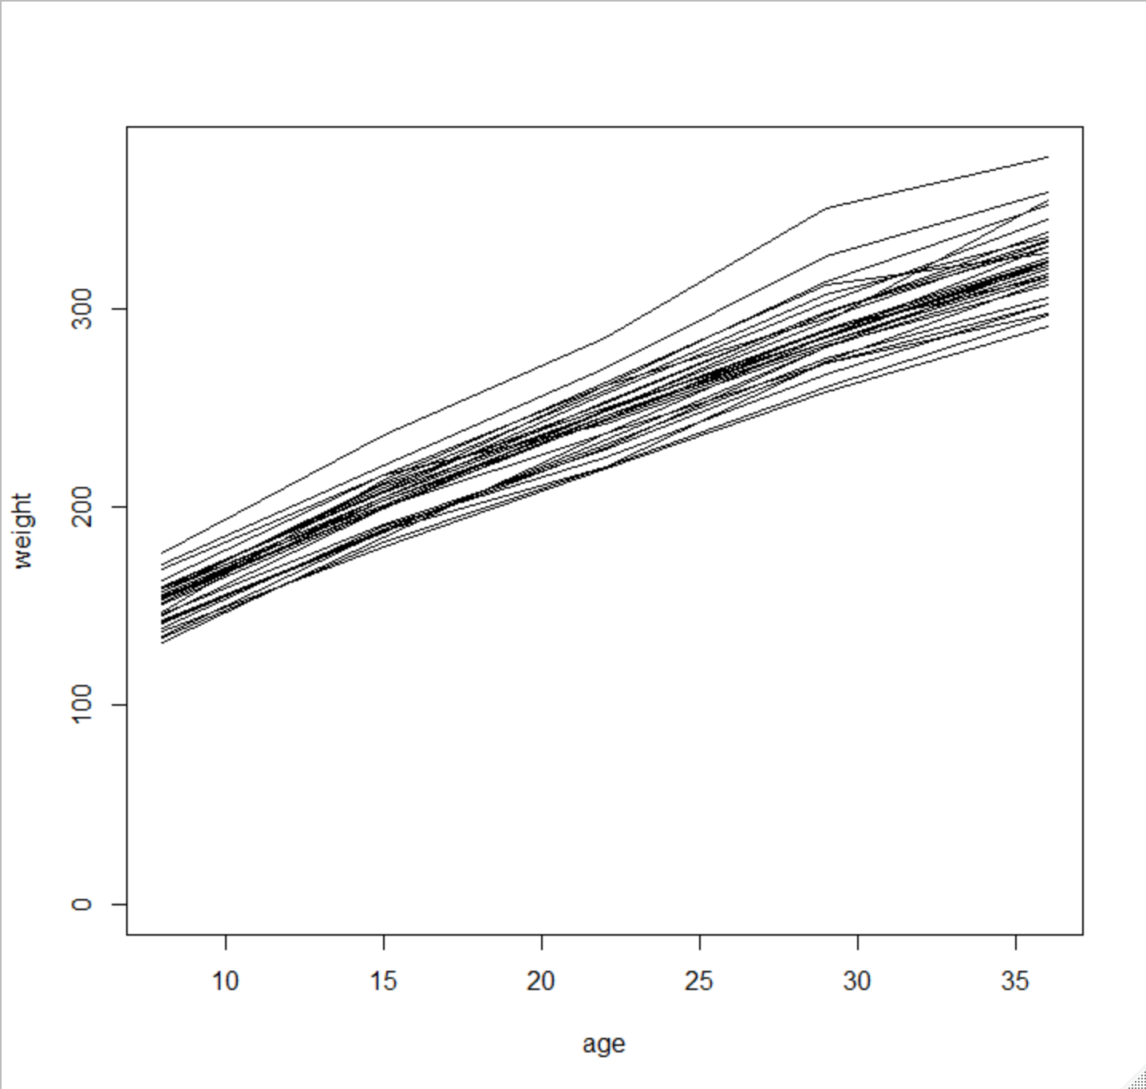
Example
Weights of 30 rats
From OpenBUGS examples
Assume linear trend for fixed effects
Fit an icm in two different implementations in stan
direct translation
stanified translation
Fit rcm in stan

